Slide 1

Guidelines for Primary Reviewers
GMP 2024

Slide 2
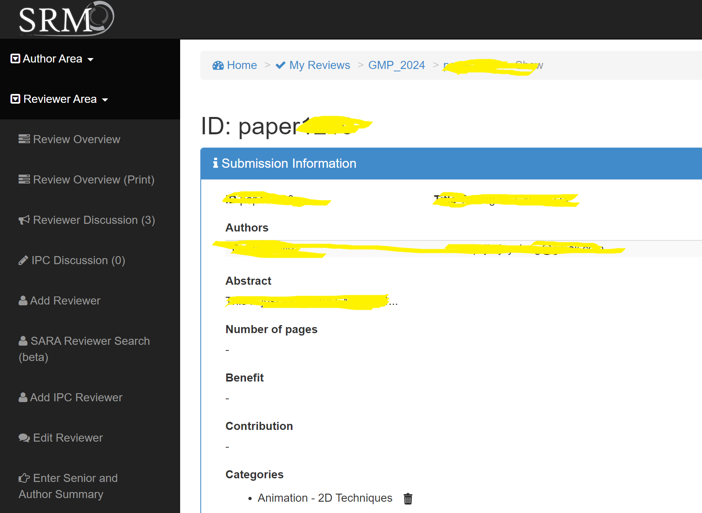
How to add external reviewers
“Add reviewer”

Slide 3
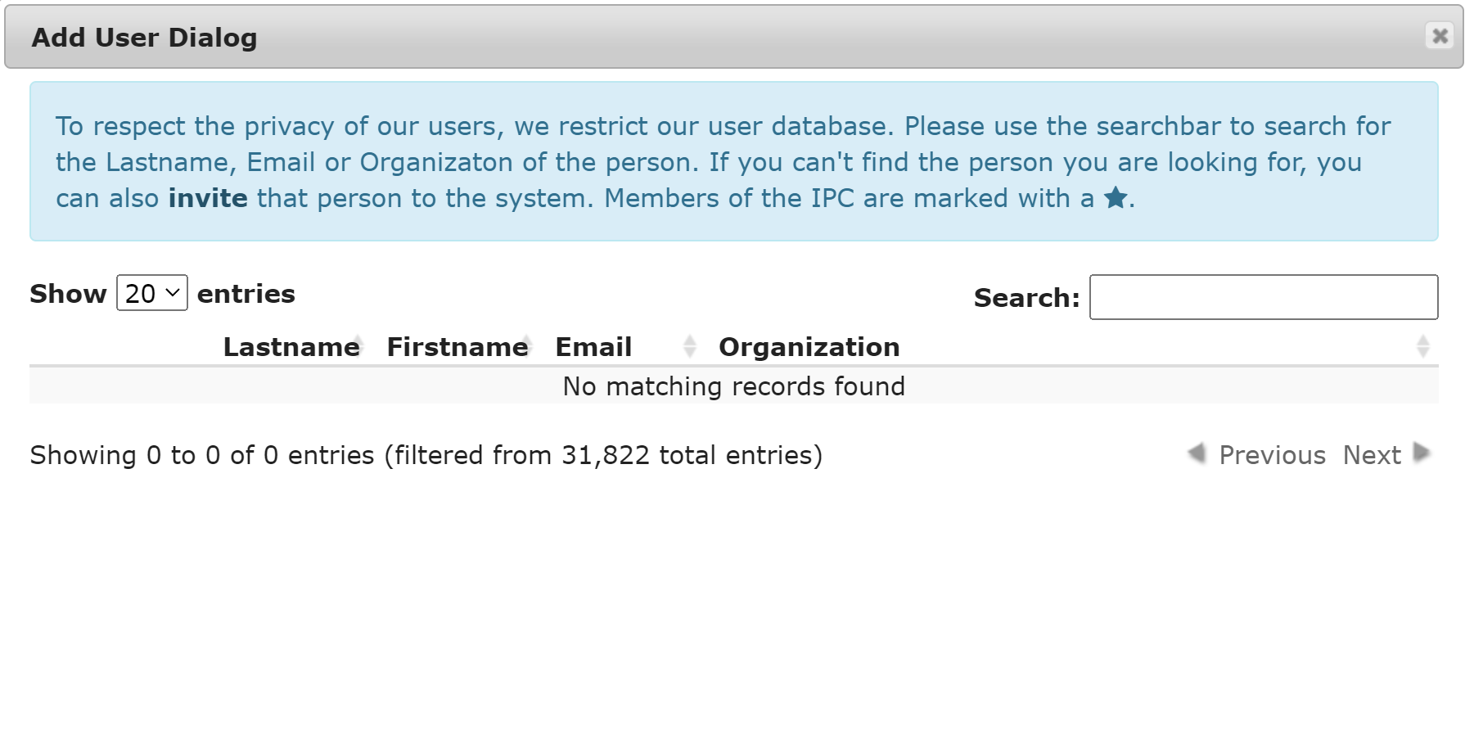
How to add external reviewers
“invite”

Slide 4
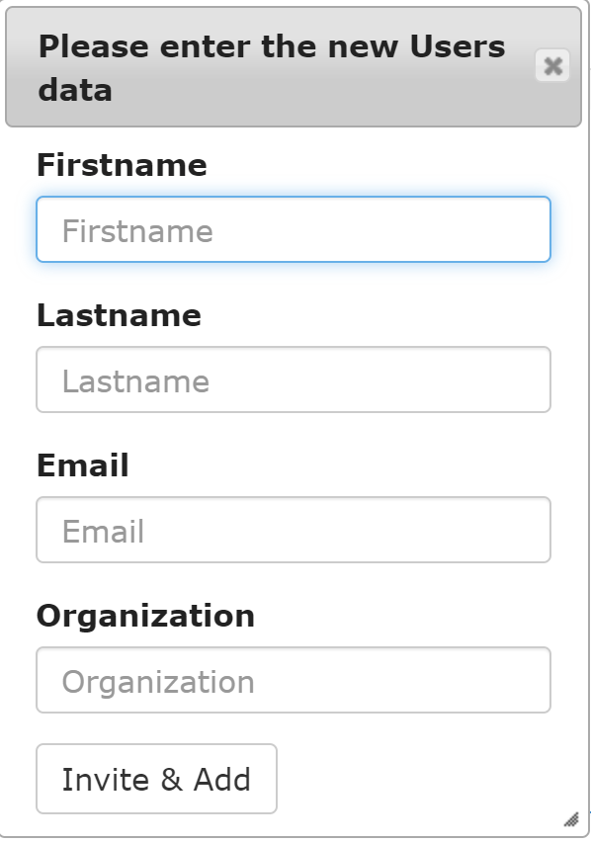
How to add external reviewers
After entering his/her information,
click “Invite & Add”

Slide 5
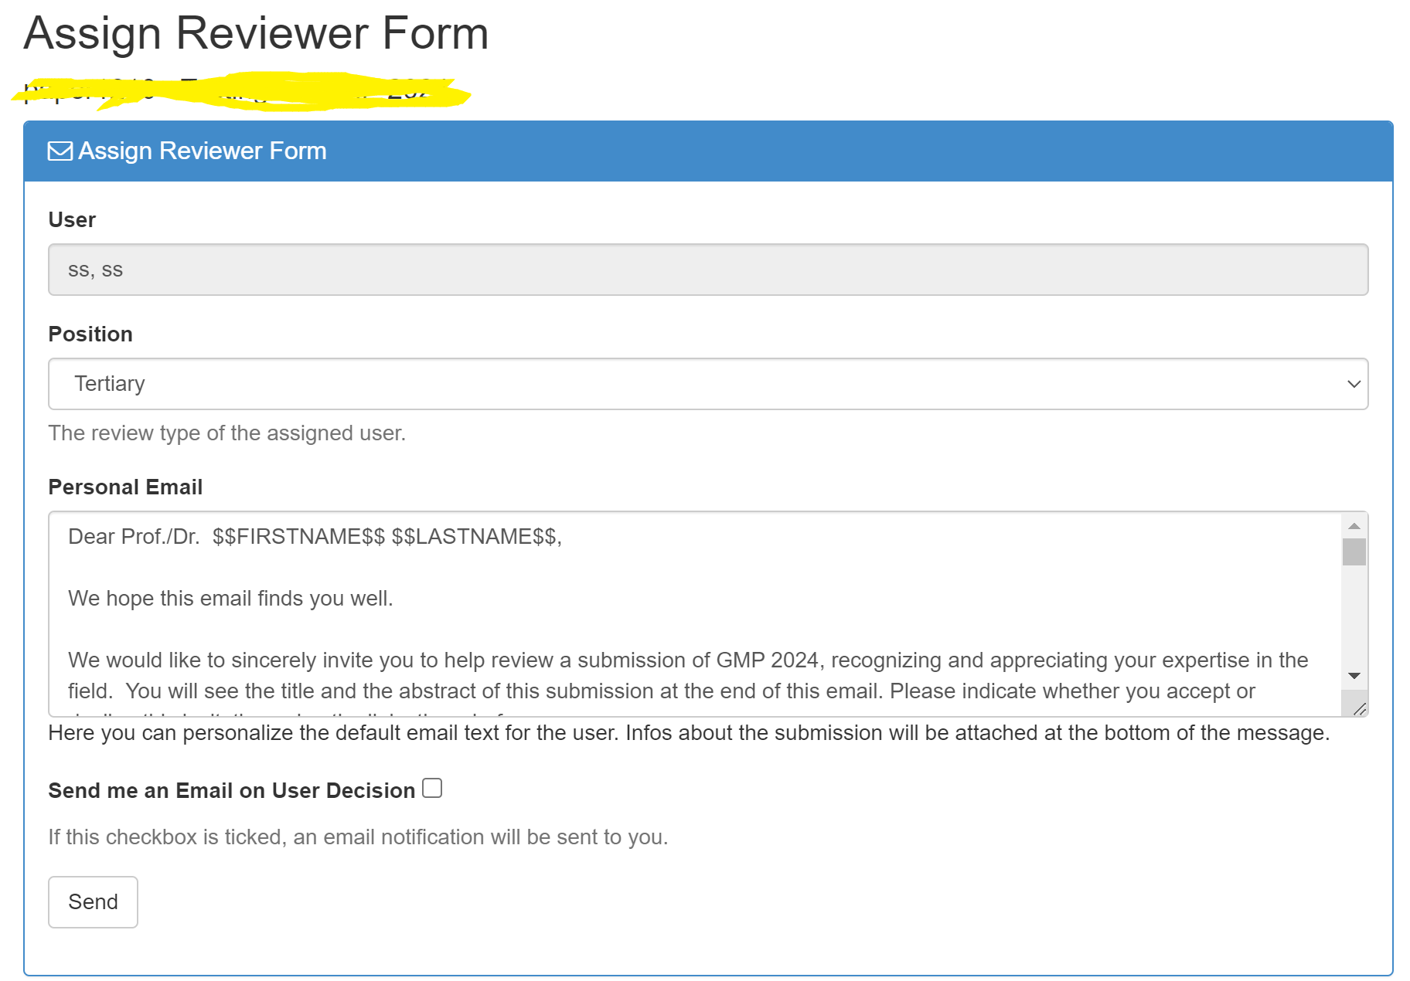
How to add external reviewers
Keep the email text unchanged
and click “send”

Slide 6
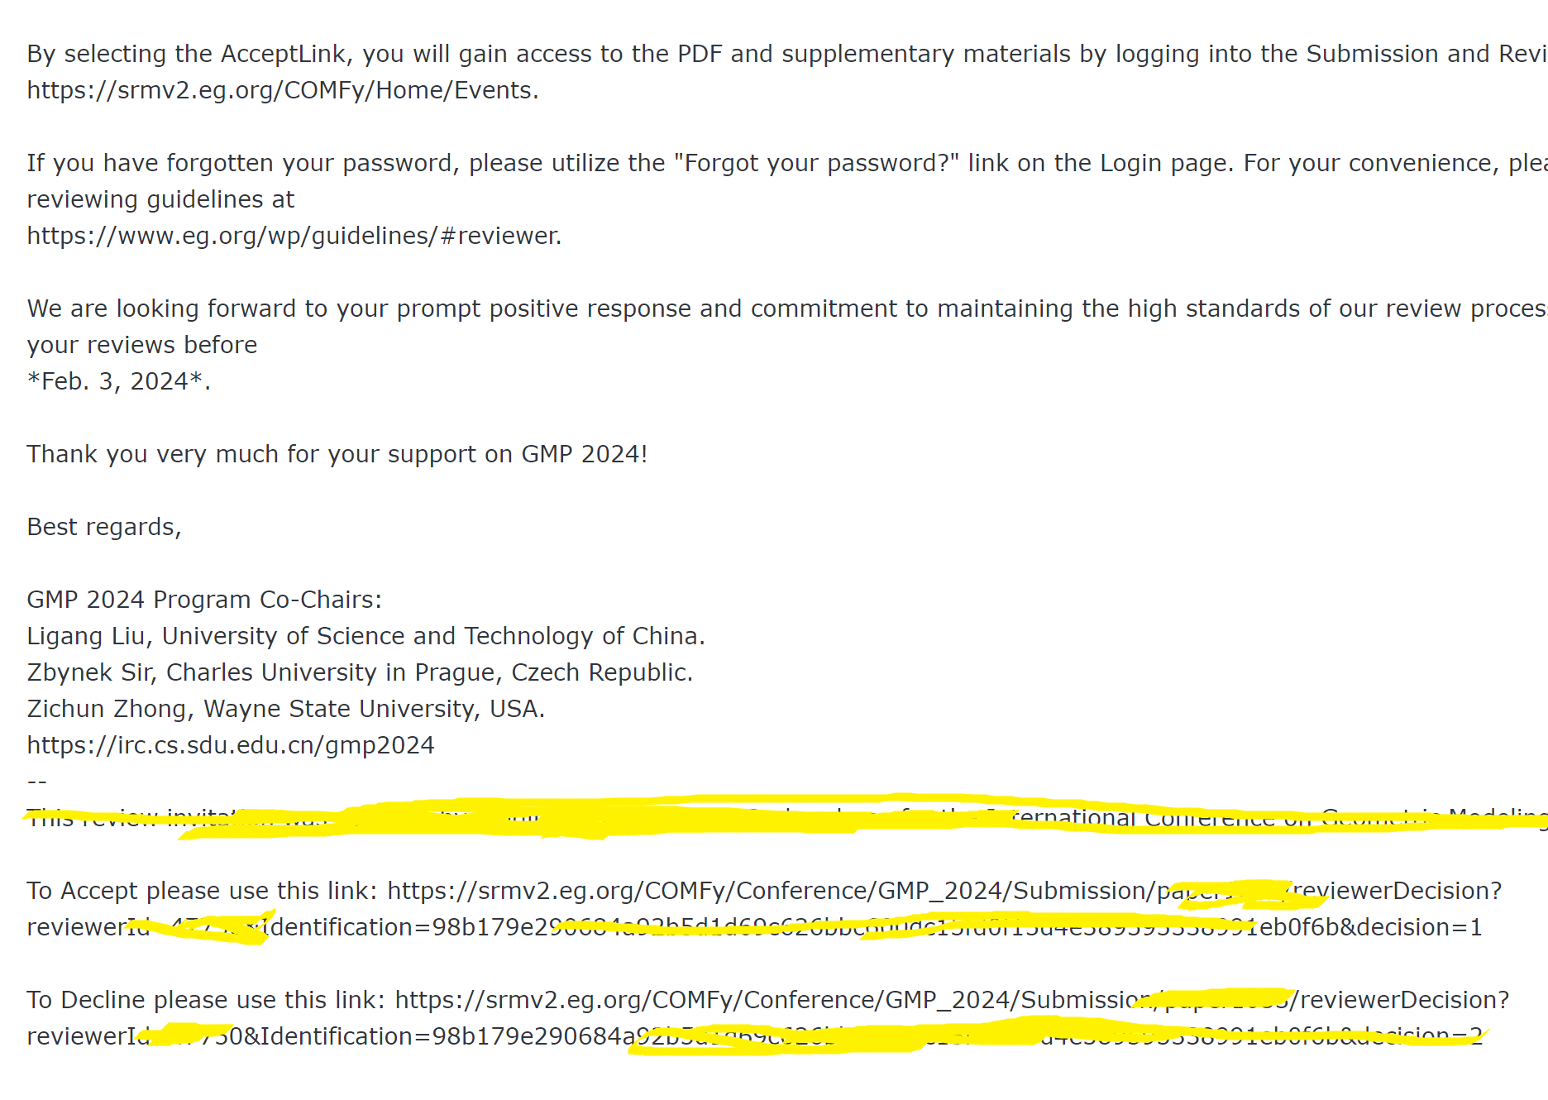
How to add external reviewers
If the reviewer you invite didn’t register on SRM, he/she will receive two emails, one of which is to remind him/her how to register, and the other email is to remind him/her to access the paper.
In the email text, there is a link
If the reviewer you invite has a SRM
account, he/she will receive one email
containing the link.
The email address for your invitation
must be the same with that used for
logging into SRM

Slide 7
Thanks!

